Slide 1

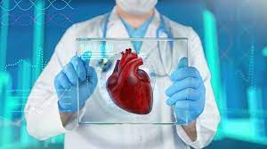
PREDICTING AND ANALYZING HEART DISEASE
USING MACHINE LEARNING ALGORITHMS

Slide 2
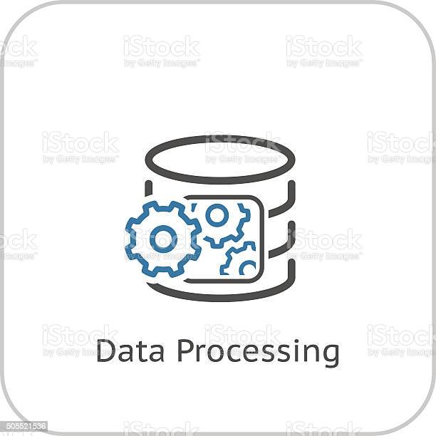



Workflow
Heart Data
Data Pre-Processing
Data Analyzing
Healthy or Heart Defect
Machine Learning Algorithm

Slide 3
TECHNOLOGIES
ALGORITHMS | Tool | PROGRAMMING LANGUAGES
K Nearest | Anaconda | Python
Random forest | Jupiter
Logistic Regression
Navie Bayes

Slide 4
THANK YOU.

